Slide 1
Path and Connectivity

Slide 2
Paths (Undirected)
Definition
A path of length n in an undirected graph is a sequence of n edges e₁, e₂, .. , e_{n} such that each consecutive pair e_{i} , e_{i+1} share a (at least) common vertex
e₁
V₀
V₁
e₂
e₃
V₃
V₂

Slide 3
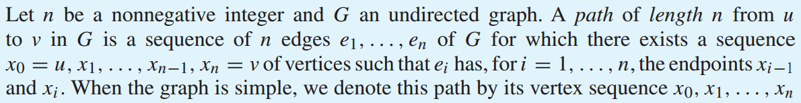
Paths (Undirected)
Definition (Rosen)
e₁
V₀
V₁
e₂
e₃
V₃
V₂

Slide 4
Paths (Undirected)
A path in a graph is a continuous way of getting from one vertex to another by using a sequence of edges.
EG: could get from 1 to 3 as follows:
e₆
e₁
1
e₂
2
e₃
e₅
e₄
e₇
3
4

Slide 5
Paths
Paths (Undirected)
A path in a graph is a continuous way of getting from one vertex to another by using a sequence of edges.
EG: could get from 1 to 3 as follows:
1-e₁→2-e₂→1-e₃→3-e₄→2-e₆→2-e₅→2-e₄→3
e₆
e₁
1
e₂
2
e₃
e₅
e₄
e₇
3
4

Slide 6
Paths
Paths (Undirected)
A path in a graph is a continuous way of getting from one vertex to another by using a sequence of edges.
EG: could get from 1 to 3 as follows:
1-e₁→2-e₂→1-e₃→3-e₄→2-e₆→2-e₅→2-e₄→3
e₆
e₁
1
e₂
2
e₃
e₅
e₄
e₇
3
4

Slide 7
Paths
Paths (Undirected)
A path in a graph is a continuous way of getting from one vertex to another by using a sequence of edges.
EG: could get from 1 to 3 as follows:
1-e₁→2-e₂→1-e₃→3-e₄→2-e₆→2-e₅→2-e₄→3
e₆
e₁
1
e₂
2
e₃
e₅
e₄
e₇
3
4

Slide 8
Paths
Paths (Undirected)
A path in a graph is a continuous way of getting from one vertex to another by using a sequence of edges.
EG: could get from 1 to 3 as follows:
1-e₁→2-e₂→1-e₃→3-e₄→2-e₆→2-e₅→2-e₄→3
e₆
e₁
1
e₂
2
e₃
e₅
e₄
e₇
3
4

Slide 9
Paths
Paths (Undirected)
A path in a graph is a continuous way of getting from one vertex to another by using a sequence of edges.
EG: could get from 1 to 3 as follows:
1-e₁→2-e₂→1-e₃→3-e₄→2-e₆→2-e₅→2-e₄→3
e₆
e₁
1
e₂
2
e₃
e₅
e₄
e₇
3
4

Slide 10
Paths
Paths (Undirected)
A path in a graph is a continuous way of getting from one vertex to another by using a sequence of edges.
EG: could get from 1 to 3 as follows:
1-e₁→2-e₂→1-e₃→3-e₄→2-e₆→2-e₅→2-e₄→3
e₆
e₁
1
e₂
2
e₃
e₅
e₄
e₇
3
4

Slide 11
Paths
Paths (Undirected)
A path in a graph is a continuous way of getting from one vertex to another by using a sequence of edges.
EG: could get from 1 to 3 as follows:
1-e₁→2-e₂→1-e₃→3-e₄→2-e₆→2-e₅→2-e₄→3
e₆
e₁
1
e₂
2
e₃
e₅
e₄
e₇
3
4

Slide 12
Paths
Paths (Undirected)
A path in a graph is a continuous way of getting from one vertex to another by using a sequence of edges.
EG: could get from 1 to 3 as follows:
1-e₁→2-e₂→1-e₃→3-e₄→2-e₆→2-e₅→2-e₄→3
e₆
e₁
1
e₂
2
e₃
e₅
e₄
e₇
3
4

Slide 13
Paths
Paths (Undirected)
A path in a graph is a continuous way of getting from one vertex to another by using a sequence of edges.
EG: could get from 1 to 3 as follows:
1-e₁→2-e₂→1-e₃→3-e₄→2-e₆→2-e₅→2-e₄→3
e₆
e₁
1
e₂
2
e₃
e₅
e₄
e₇
3
4

Slide 14
Paths
Simple Path
A path or circuit is simple if it does not contain the same edge more than once. (though duplicate vertices are allowed).
A cycle (or circuit)
A cycle (or circuit) is a path which starts and ends at the same vertex.
A path of 0 length has 1 vertex with 0 edge.

Slide 15
Is it cycle?
Consider the following graph
find the start and end point for cycle
e₁
V₀
V₁
e₄
e₂
e₃
V₃
V₂

Slide 16
Paths
Paths
Q: Find a longest possible simple path from 1 to 2 in the following graph:
e₆
e₁
1
e₂
2
e₃
e₅
e₄
e₇
3
4

Slide 17
Paths
Paths
A: The following path from 1 to 2 is a maximal simple path because
simple: each of its edges appears exactly once
maximal: because it contains every edge except the unreachable edge e₇
The maximal path: e₁, e₅, e₆, e₂, e₃, e₄
e₁
e₆
1
e₂
2
e₃
e₅
e₄
e₇
3
4

Slide 18
Paths (Directed)
A path of length n in a directed graph is a sequence of n edges e₁, e₂, … ,e_{n} such that the target of e_{i} is the source e_{i+1} for each i.
e₁
V₀
V₁
e₄
e₂
e₃
V₃
V₂

Slide 19
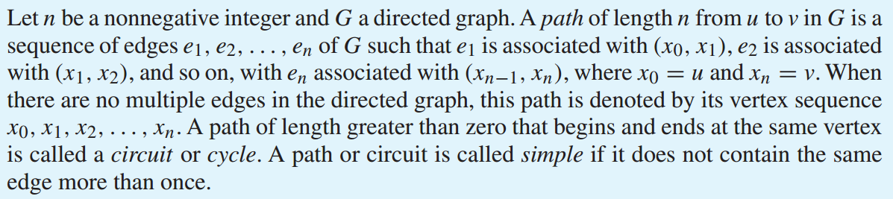
Paths (Directed)
Definition

Slide 20
Connectedness in Undirected Graphs
Definition
An undirected graph is called connected if there is a path between every pair of distinct vertices of the graph. An undirected graph that is not connected is called disconnected.

Slide 21
Is it Connected?
e₁
V₀
V₁
e₄
e₂
e₃
V₃
V₂

Slide 22
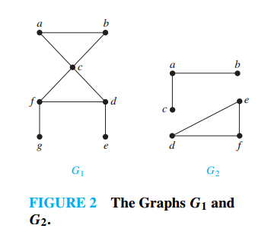
Connectedness in Undirected Graphs

Slide 23
Q: Which of the following graphs are connected?
1
2
3
4

Slide 24
A: First and second are disconnected. Last is connected.
1
2
3
4

Slide 25
A: First and second are disconnected. Last is connected.
1
2
3
4

Slide 26
A: First and second are disconnected. Last is connected.
1
2
3
4

Slide 27
A: First and second are disconnected. Last is connected.
1
2
3
4

Slide 28
A: First and second are disconnected. Last is connected.
1
2
3
4

Slide 29
A: First and second are disconnected. Last is connected.
1
2
3
4

Slide 30
Connectedness in Directed Graphs
Strongly Connected
Weakly Connected
Definition
A directed graph is strongly connected if there is a path from a to b and from b to a whenever a and b are vertices in the graph.
A directed graph is weakly connected if there is a path between every two vertices in the underlying undirected graph.

Slide 31
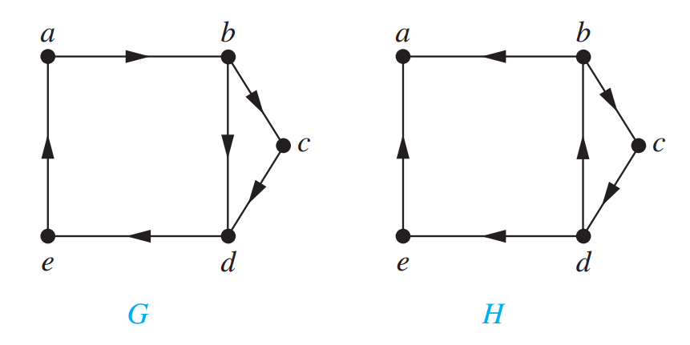
Strongly Connected

